Slide 1

Introduction to Algorithms
Lecture 2 Algorithm Analysis
Understanding Performance of Your Algorithm
Yao-Chung Fan
yfan@nchu.edu.tw
Notes:
[wayne s14] I always seem to run over. Consider cutting percolation.
[wayne s14] modified terminology to use connected (instead of find)
[wayne s12] weighted quick union and quick union not identical when two trees have same size. Suggest changing quick union to break ties differently since the demos for weighted quick union would require more work to fix.

Slide 2
Example Problem: 3-Sum
3-Sum. Given N distinct integers, how many triples sum to exactly zero?
Context. Deeply related to problems in computational geometry.
% more 8ints.txt
8
30 -40 -20 -10 40 0 10 5
% java ThreeSum 8ints.txt
4
a[i] | a[j] | a[k] | sum
30 | -40 | 10 | 0
30 | -20 | -10 | 0
-40 | 40 | 0 | 0
-10 | 0 | 10 | 0
1
2
3
4
Notes:
distinctness of integers not crucial to problem (but simplifies code for N^2 log N algorithm discussed later)

Slide 3
3-Sum: brute-force algorithm
Brute-force algorithm. Check each triple.
public class ThreeSum
{
public static int count(int[] a)
{
int N = a.length;
int count = 0;
for (int i = 0; i < N; i++)
for (int j = i+1; j < N; j++)
for (int k = j+1; k < N; k++)
if (a[i] + a[j] + a[k] == 0)
count++;
return count;
}
public static void main(String[] args)
{
In in = new In(args[0]);
int[] a = in.readAllInts();
StdOut.println(count(a));
}
}
check each triple
for simplicity, ignore integer overflow
Notes:
this method counts the number of triples (i < j < k to avoid double counting)

Slide 4
Measuring the running time
Q. How to time a program?
A. Automatic.
public class Stopwatch
 | Stopwatch() |  | create a new stopwatch
double | elapsedTime() |  | time since creation (in seconds)
public static void main(String[] args)
{
In in = new In(args[0]);
int[] a = in.readAllInts();
Stopwatch stopwatch = new Stopwatch();
StdOut.println(ThreeSum.count(a));
double time = stopwatch.elapsedTime();
StdOut.println("elapsed time " + time);
}
client code

Slide 5
Measuring the running time
Q. How to time a program?
A. Automatic.
public class Stopwatch
 | Stopwatch() |  | create a new stopwatch
double | elapsedTime() |  | time since creation (in seconds)
public class Stopwatch
{
private final long start = System.currentTimeMillis();
public double elapsedTime()
{
long now = System.currentTimeMillis();
return (now - start) / 1000.0;
}
}

Slide 6


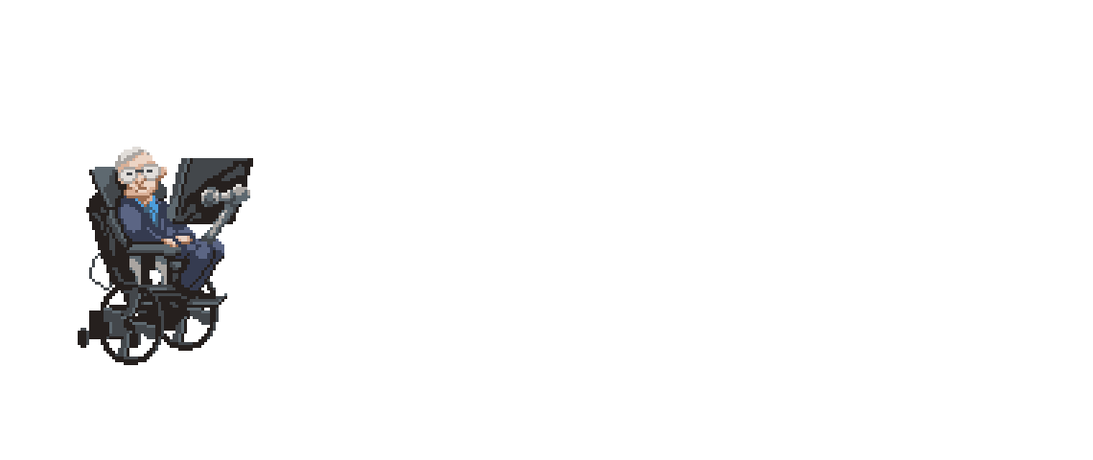
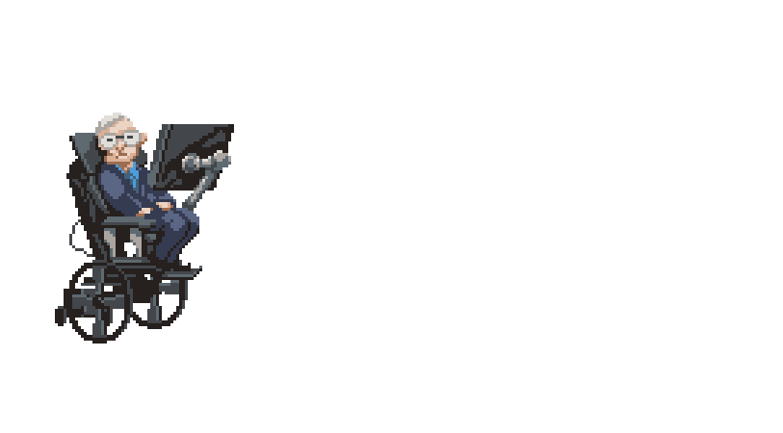
Empirical analysis (猜猜看要跑多久？)
Run the program for various input sizes and measure running time.
Notes:
Click movie to run
Run ThreeSum.java in class from the command-line and wait for it to finish, perhaps N = 500, 1000, 2000, and 4000.
Ask students to make predictions.

Slide 7
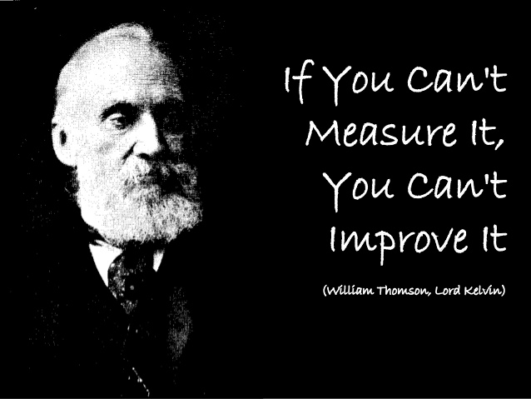
About Algorithm Analysis

Slide 8
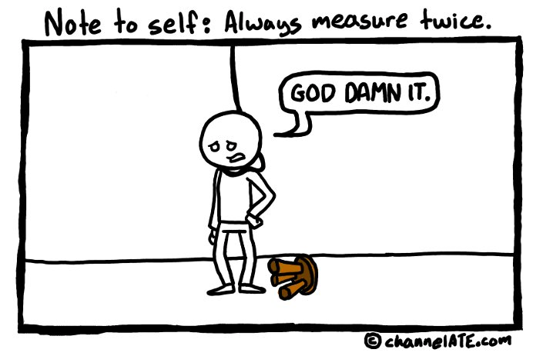

Slide 9
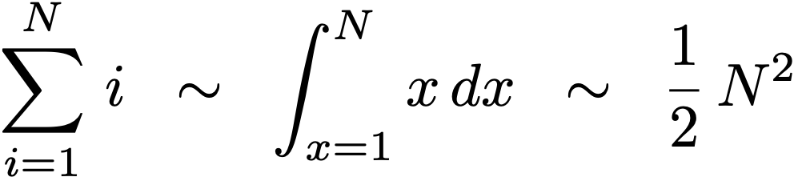
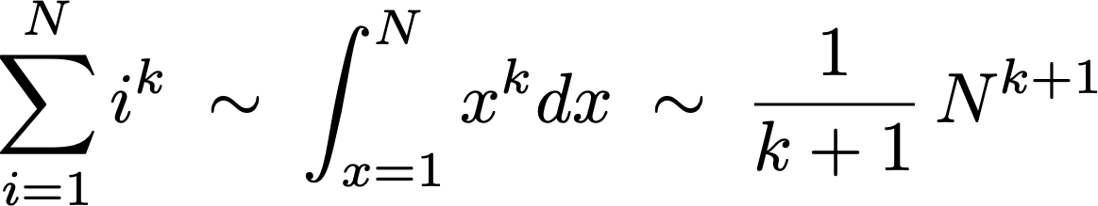
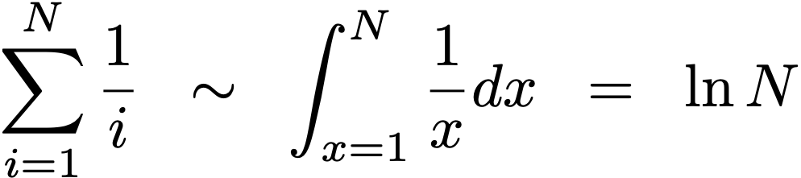
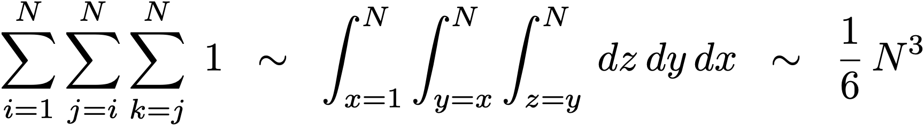
Diversion: estimating a discrete sum
Q. How to estimate a discrete sum?
A1. Take a discrete mathematics course.
A2. Replace the sum with an integral, and use calculus!
Ex 1. 1 + 2 + … + N.
Ex 2. 1^{k} + 2^{k} + … + N ^{k}.
Ex 3. 1 + 1/2 + 1/3 + … + 1/N.
Ex 4. 3-sum triple loop.
Notes:
triangular sum, sum of powers, harmonic sum, N choose 3
works when function is increasing
\sum_{i=1}^N i^k \; \sim \; \int_{x=1}^N x^k dx \; \sim \; \frac{1}{k+1} \, N^{k+1}

Slide 10

Mathematical models for running time
In principle, accurate mathematical models are available.
In practice,
Formulas can be complicated.
Advanced mathematics might be required.
Exact models best left for experts.
Bottom line. We use approximate models in this course: T(N) ∼ c N ³.
costs (depend on machine, compiler)
TN = c1 A + c2 B + c3 C + c4 D + c5 E
A = array access
B = integer add
C = integer compare
D = increment
E = variable assignment
frequencies
(depend on algorithm, input)

Slide 11

The challenge: Understand the Performance of Your Algorithm
Q. Will my program be able to solve a large practical input?
Insight. [Knuth 1970s] Use scientific method to understand performance.
Why is my program so slow ?
What happen when the input is scale to 100x?

Slide 12
Analysis of Algorithms
introduction
mathematical models
order-of-growth classifications
theory of algorithms
memory

Slide 13
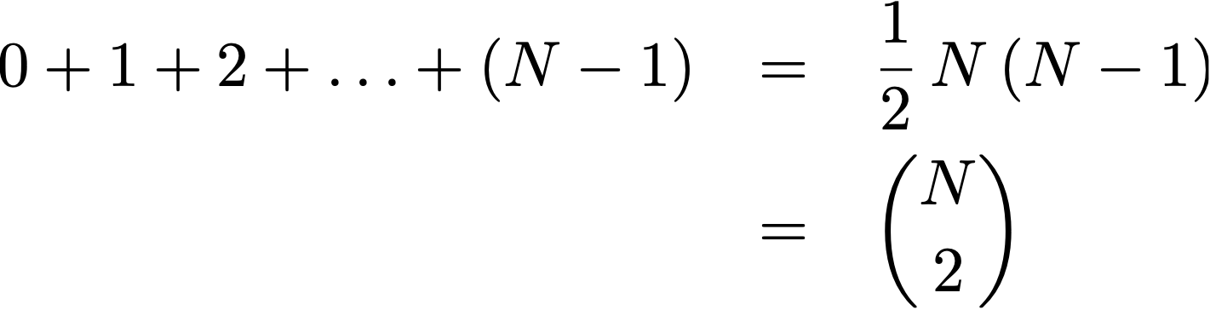
How long does the following algorithm take ?
Q. How many instructions as a function of input size N ?
int count = 0;
for (int i = 0; i < N; i++)
for (int j = i+1; j < N; j++)
if (a[i] + a[j] == 0)
count++;
operation | frequency
variable declaration | N + 2
assignment statement | N + 2
less than compare | ½ (N + 1) (N + 2)
equal to compare | ½ N (N − 1)
array access | N (N − 1)
increment | ½ N (N − 1) to N (N − 1)
tedious to count exactly
Notes:
N(N-1) instead of ½ N(N-1) because there are two array accesss per inner loop

Slide 14
Common order-of-growth classifications
Definition. If T(N) ~ c g(N) for some constant c > 0, then the order of growth of T(N) is g(N).
Ignores leading coefficient.
Ignores lower-order terms.
Ex. The order of growth of the running time of this code is N ³.
where leading coefficient
depends on machine, compiler, JVM, ...
int count = 0;
for (int i = 0; i < N; i++)
for (int j = i+1; j < N; j++)
for (int k = j+1; k < N; k++)
if (a[i] + a[j] + a[k] == 0)
count++;

Slide 15
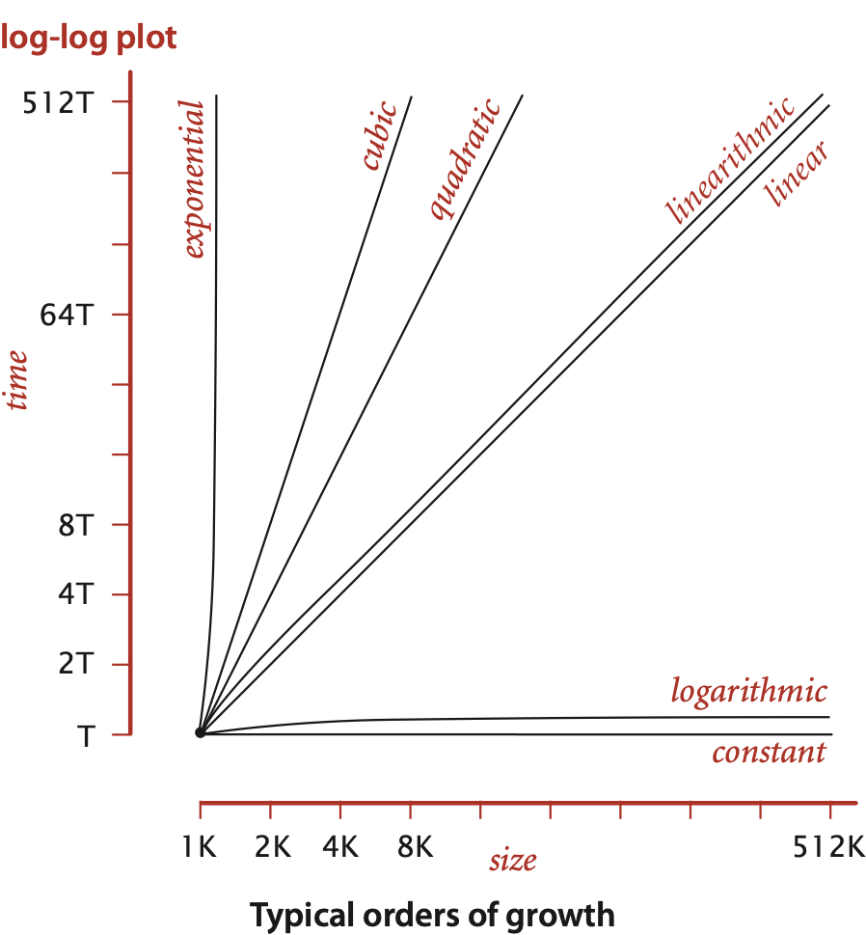
Common order-of-growth classifications
Good news. The set of functions 1, log N, N, N log N, N ², N ³, and 2^{N}
suffices to describe the order of growth of most common algorithms.
Notes:
reason: programs are comprised of just a few structural primitives: statements, loops, conditionals, nesting, function calls

Slide 16
Common order-of-growth classifications
order of growth | name | typical code framework | description | example | T(2N) / T(N)
1 | constant | a = b + c; | statement | add two numbers | 1
log N | logarithmic | while (N > 1) { N = N / 2; ... } | divide in half | binary search | ~ 1
N | linear | for (int i = 0; i < N; i++) { ... } | loop | find the maximum | 2
N log N | linearithmic | [see mergesort lecture] | divide and conquer | mergesort | ~ 2
N ² | quadratic | for (int i = 0; i < N; i++) for (int j = 0; j < N; j++) { ... } | double loop | check all pairs | 4
N ³ | cubic | for (int i = 0; i < N; i++) for (int j = 0; j < N; j++) for (int k = 0; k < N; k++) { ... } | triple loop | check all triples | 8
2^{N} | exponential | [see combinatorial search lecture] | exhaustive search | check all subsets | T(N)
Notes:
this partially explains reason why small set of functions
arises from straightforward composition of loops, conditionals, functions
T(2N) / T(N) is factor for doubling hypothesis

Slide 17
Binary Search Review
Given a Sorted Array A and a key k,
return the index of k in A

Slide 18
Binary search demo
Goal. Given a sorted array and a key, find index of the key in the array?
Binary search. Compare key against middle entry.
Too small, go left.
Too big, go right.
Equal, found.
successful search for 33
6 | 13 | 14 | 25 | 33 | 43 | 51 | 53 | 64 | 72 | 84 | 93 | 95 | 96 | 97
0 | 1 | 2 | 3 | 4 | 5 | 6 | 7 | 8 | 9 | 10 | 11 | 12 | 13 | 14
lo
mid
hi

Slide 19
Binary search demo
Goal. Given a sorted array and a key, find index of the key in the array?
Binary search. Compare key against middle entry.
Too small, go left.
Too big, go right.
Equal, found.
successful search for 33
6 | 13 | 14 | 25 | 33 | 43 | 51 | 53 | 64 | 72 | 84 | 93 | 95 | 96 | 97
0 | 1 | 2 | 3 | 4 | 5 | 6 | 7 | 8 | 9 | 10 | 11 | 12 | 13 | 14
lo
mid
hi

Slide 20
Binary search demo
Goal. Given a sorted array and a key, find index of the key in the array?
Binary search. Compare key against middle entry.
Too small, go left.
Too big, go right.
Equal, found.
successful search for 33
6 | 13 | 14 | 25 | 33 | 43 | 51 | 53 | 64 | 72 | 84 | 93 | 95 | 96 | 97
0 | 1 | 2 | 3 | 4 | 5 | 6 | 7 | 8 | 9 | 10 | 11 | 12 | 13 | 14
lo
mid
hi

Slide 21
Binary search demo
Goal. Given a sorted array and a key, find index of the key in the array?
Binary search. Compare key against middle entry.
Too small, go left.
Too big, go right.
Equal, found.
successful search for 33
lo = hi
6 | 13 | 14 | 25 | 33 | 43 | 51 | 53 | 64 | 72 | 84 | 93 | 95 | 96 | 97
0 | 1 | 2 | 3 | 4 | 5 | 6 | 7 | 8 | 9 | 10 | 11 | 12 | 13 | 14
mid
return 4

Slide 22
Binary search demo
Goal. Given a sorted array and a key, find index of the key in the array?
Binary search. Compare key against middle entry.
Too small, go left.
Too big, go right.
Equal, found.
unsuccessful search for 34
6 | 13 | 14 | 25 | 33 | 43 | 51 | 53 | 64 | 72 | 84 | 93 | 95 | 96 | 97
0 | 1 | 2 | 3 | 4 | 5 | 6 | 7 | 8 | 9 | 10 | 11 | 12 | 13 | 14
lo
mid
hi

Slide 23
Binary search demo
Goal. Given a sorted array and a key, find index of the key in the array?
Binary search. Compare key against middle entry.
Too small, go left.
Too big, go right.
Equal, found.
unsuccessful search for 34
6 | 13 | 14 | 25 | 33 | 43 | 51 | 53 | 64 | 72 | 84 | 93 | 95 | 96 | 97
0 | 1 | 2 | 3 | 4 | 5 | 6 | 7 | 8 | 9 | 10 | 11 | 12 | 13 | 14
lo
mid
hi

Slide 24
Binary search demo
Goal. Given a sorted array and a key, find index of the key in the array?
Binary search. Compare key against middle entry.
Too small, go left.
Too big, go right.
Equal, found.
unsuccessful search for 34
6 | 13 | 14 | 25 | 33 | 43 | 51 | 53 | 64 | 72 | 84 | 93 | 95 | 96 | 97
0 | 1 | 2 | 3 | 4 | 5 | 6 | 7 | 8 | 9 | 10 | 11 | 12 | 13 | 14
lo
mid
hi

Slide 25
Binary search demo
Goal. Given a sorted array and a key, find index of the key in the array?
Binary search. Compare key against middle entry.
Too small, go left.
Too big, go right.
Equal, found.
unsuccessful search for 34
lo = hi
6 | 13 | 14 | 25 | 33 | 43 | 51 | 53 | 64 | 72 | 84 | 93 | 95 | 96 | 97
0 | 1 | 2 | 3 | 4 | 5 | 6 | 7 | 8 | 9 | 10 | 11 | 12 | 13 | 14
mid
return -1

Slide 26
Binary search: Java implementation
Trivial to implement
Invariant. If key appears in the array a[], then a[lo] ≤ key ≤ a[hi].
public static int rank(int key, int[] a)
{
int lo = 0, hi = a.length-1;
while (lo <= hi)
{
int mid = lo + (hi - lo) / 2;
if (key < a[mid]) hi = mid - 1;
else if (key > a[mid]) lo = mid + 1;
else return mid;
}
return -1;
}
one "3-way compare"
Notes:
Simple algorithm but notorious to get details exactly right. Indication of care we need to take to develop libraries that will be used by millions of programmers.
Easy to convince ourselves that the program works as advertised by considering the invariant.
Q. Why lo + (hi - lo) / 2 instead of (lo + hi) / 2 ?
A. Avoid overflow.
Q. What was bug in Java 1.5?
A. mid = (lo + hi) >> 1 instead of (lo + hi) >>> 1. Former susceptible to int overflow for very large arrays.

Slide 27
Binary search: mathematical analysis
Proposition. Binary search uses at most 1 + lg N key compares to search in a sorted array of size N.
Def. T (N) = # key compares to binary search a sorted subarray of size N.
Binary search recurrence. T (N) = T (N / 2) + 1 for N > 1, with T (1) = 1.
Pf sketch. [assume N is a power of 2]
left or right half
(floored division)
T (N) | = | T (N / 2) + 1 | [ given ]
 | = | T (N / 4) + 1 + 1 | [ apply recurrence to first term ]
 | = | T (N / 8) + 1 + 1 + 1 | [ apply recurrence to first term ]
 | ⋮
 | = | T (N / N) + 1 + 1 + … + 1 | [ stop applying, T(1) = 1 ]
 | = | 1 + lg N
Notes:
We count 3-way compares
Here N/2 means integer division, i.e., floor(N/2)
slight cheat because N is not always a power of two
possible to implement with one 2-way compare (instead of 3-way) by deferring equality check until subarray size is 1

Slide 28
Common order-of-growth classifications
order of growth | name | typical code framework | description | example | T(2N) / T(N)
1 | constant | a = b + c; | statement | add two numbers | 1
log N | logarithmic | while (N > 1) { N = N / 2; ... } | divide in half | binary search | ~ 1
N | linear | for (int i = 0; i < N; i++) { ... } | loop | find the maximum | 2
N log N | linearithmic | [see mergesort lecture] | divide and conquer | mergesort | ~ 2
N ² | quadratic | for (int i = 0; i < N; i++) for (int j = 0; j < N; j++) { ... } | double loop | check all pairs | 4
N ³ | cubic | for (int i = 0; i < N; i++) for (int j = 0; j < N; j++) for (int k = 0; k < N; k++) { ... } | triple loop | check all triples | 8
2^{N} | exponential | [see combinatorial search lecture] | exhaustive search | check all subsets | T(N)
Notes:
this partially explains reason why small set of functions
arises from straightforward composition of loops, conditionals, functions
T(2N) / T(N) is factor for doubling hypothesis

Slide 29
Practical implications of order-of-growth
N size scale ? N的規模。
growth rate | problem size solvable in minutes
 | 1970s | 1980s | 1990s | 2000s
1 | any | any | any | any
log N | any | any | any | any
N | millions | tens of millions | hundreds of millions | billions
N log N | hundreds of thousands | millions | millions | hundreds of millions
N² | hundreds | thousand | thousands | tens of thousands
N³ | hundred | hundreds | thousand | thousands
2^{N} | 20 | 20s | 20s | 30

Slide 30
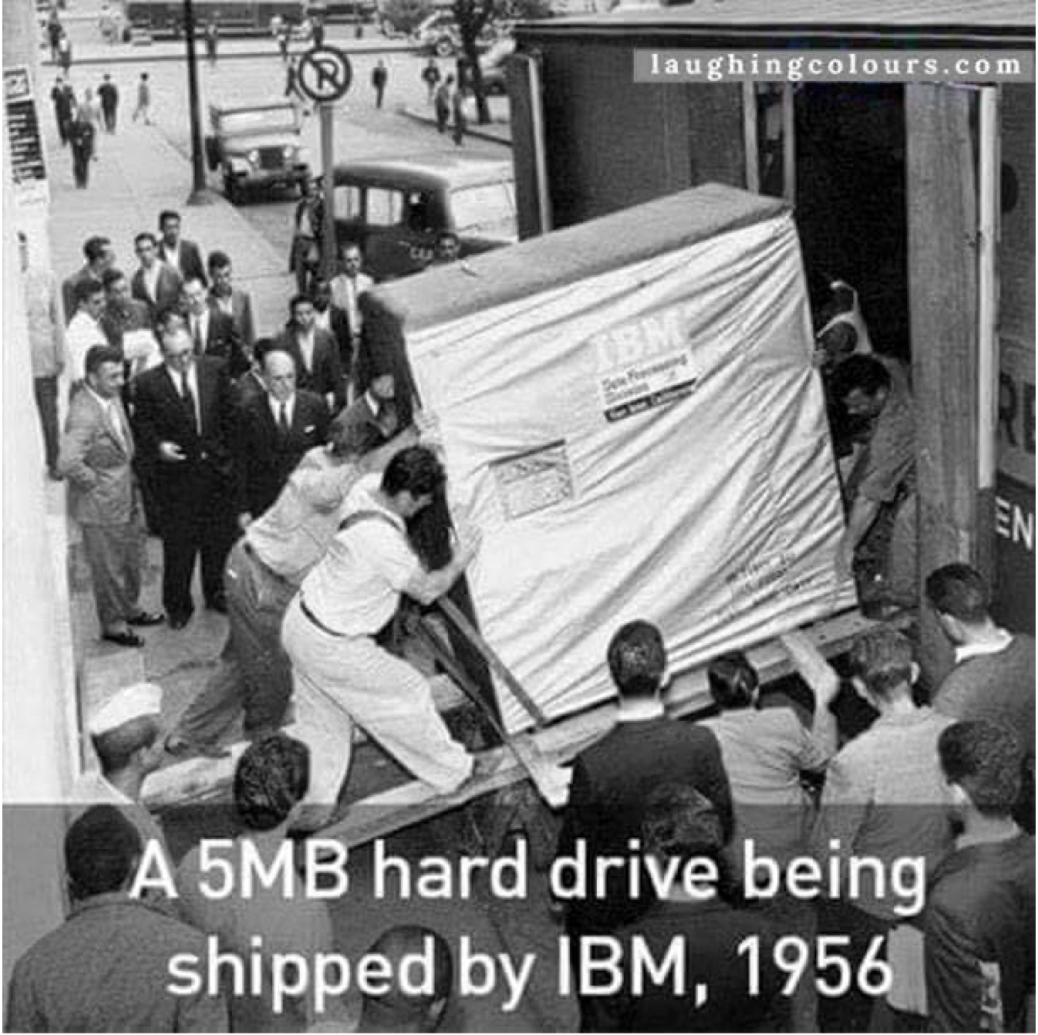

Slide 31
Practical implications of order-of-growth
growth rate | problem size solvable in minutes |  |  |  | time to process millions of inputs
 | 1970s | 1980s | 1990s | 2000s | 1970s | 1980s | 1990s | 2000s
1 | any | any | any | any | instant | instant | instant | instant
log N | any | any | any | any | instant | instant | instant | instant
N | millions | tens of millions | hundreds of millions | billions | minutes | seconds | second | instant
N log N | hundreds of thousands | millions | millions | hundreds of millions | hour | minutes | tens of seconds | seconds
N² | hundreds | thousand | thousands | tens of thousands | decades | years | months | weeks
N³ | hundred | hundreds | thousand | thousands | never | never | never | millennia
Ｎ＝1,000,000

Slide 32
Practical implications of order-of-growth
growth rate | name | description | effect on a program that runs for a few seconds
 |  |  | time for 100x more data | size for 100x faster computer
1 | constant | independent of input size | – | –
log N | logarithmic | nearly independent of input size | – | –
N | linear | optimal for N inputs | a few minutes | 100x
N log N | linearithmic | nearly optimal for N inputs | a few minutes | 100x
N² | quadratic | not practical for large problems | several hours | 10x
N³ | cubic | not practical for medium problems | several weeks | 4–5x
2^{N} | exponential | useful only for tiny problems | forever | 1x

Slide 33

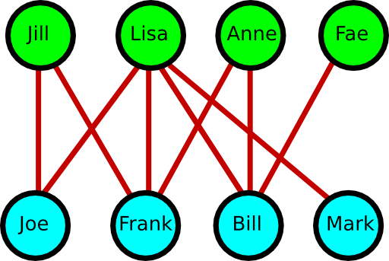
Consider the following scenario in your future
how to write a problem to assist couple matching?

Slide 34

Consider the following scenario in your future

Slide 35

Here Comes a Challenge
growth rate | problem size solvable in minutes |  |  |  | time to process millions of inputs
 | 1970s | 1980s | 1990s | 2000s | 1970s | 1980s | 1990s | 2000s
1 | any | any | any | any | instant | instant | instant | instant
log N | any | any | any | any | instant | instant | instant | instant
N | millions | tens of millions | hundreds of millions | billions | minutes | seconds | second | instant
N log N | hundreds of thousands | millions | millions | hundreds of millions | hour | minutes | tens of seconds | seconds
N² | hundreds | thousand | thousands | tens of thousands | decades | years | months | weeks
N³ | hundred | hundreds | thousand | thousands | never | never | never | millennia
how to address the challenge?

Slide 36
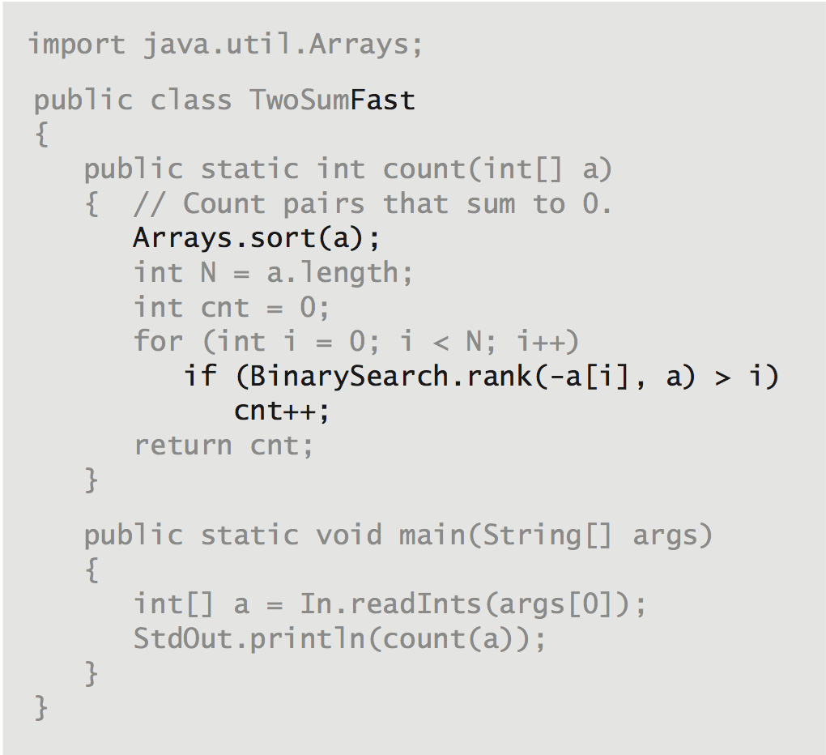
TwoSumFast

Slide 37
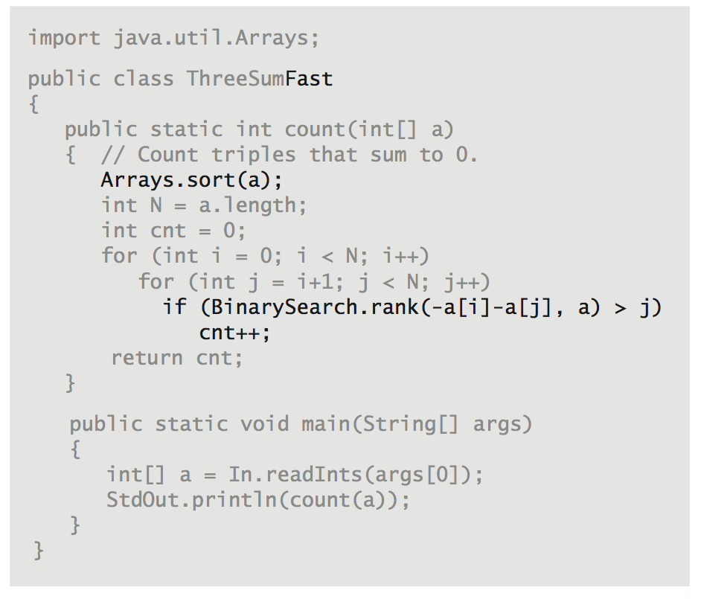
ThreeSumFast ???

Slide 38
An N² log N algorithm for 3-Sum
input
30 -40 -20 -10 40 0 10 5
Algorithm.
Step 1: Sort the N (distinct) numbers.
Step 2: For each pair of numbers a[i] and a[j], binary search for -(a[i] + a[j]).
Analysis. Order of growth is N ² log N.
Step 1: N ² with a sort.
Step 2: N ² log N with binary search.
Remark. Can achieve N ² by modifying binary search step.
sort
-40 -20 -10 0 5 10 30 40
binary search
(-40, -20) 60
(-40, -10) 50
(-40, 0) 40
(-40, 5) 35
(-40, 10) 30
⋮ ⋮
(-20, -10) 30
⋮ ⋮
(-10, 0) 10
⋮ ⋮
( 10, 30) -40
( 10, 40) -50
( 30, 40) -70
Notes:
Note: we insist upon the N numbers to be distinct; otherwise, there are more corner cases to deal with.
Instead of only counting if a[i] < a[j] < a[k], could binary search in subarray a[j+1..N-1]

Slide 39
Comparing programs
Hypothesis. The sorting-based N ² log N algorithm for 3-Sum is significantly faster in practice than the brute-force N ³ algorithm.
Guiding principle. Typically, better order of growth ⇒ faster in practice.
N | time (seconds)
1.000 | 0,1
2.000 | 0,8
4.000 | 6,4
8.000 | 51,1
N | time (seconds)
1.000 | 0,14
2.000 | 0,18
4.000 | 0,34
8.000 | 0,96
16.000 | 3,67
32.000 | 14,88
64.000 | 59,16
ThreeSum.java
ThreeSumFast.java

Slide 40

Homework Assignment #2
We need more speed for threesum problem
public class Algorithm3SumFastest
int | count(int a[]) | return the number of triples whose sum equals to zero
No delay is allowed.

Slide 41
Analysis of Algorithms
doubling hypothesis

Slide 42
Experimental algorithmics
System independent effects.
Algorithm.
Input data.
System dependent effects.
Hardware: CPU, memory, cache, …
Software: compiler, interpreter, garbage collector, …
System: operating system, network, other apps, …
What if we do not get source codes for an API?
Bad news. Difficult to get precise measurements. Good news. Much easier and cheaper than other sciences.
Notes:
CPU use by other applications: if connected to Internet, some hacker is using your computer to send spam, steal your money, etc.
Good news: compared to other scientists, running computational experiments is easy. Don't need to kill cows, blow up islands.

Slide 43
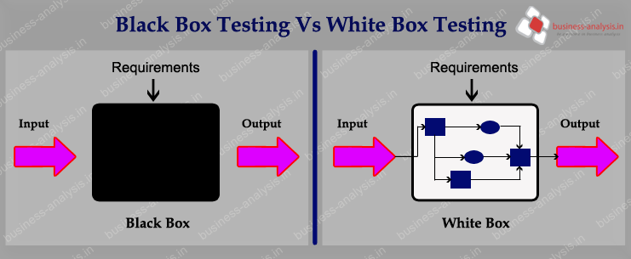
About Software Performance Understanding
黑箱測試 (Black Box Testing)
白箱測試 (White Box Testing)

Slide 44
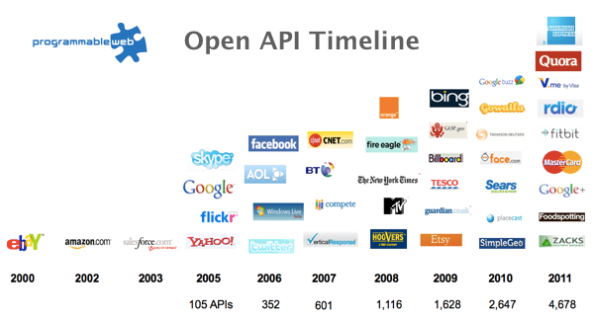
It’s API world now

Slide 45
Empirical analysis
Run the program for various input sizes and measure running time.
N | time (seconds) †
250 | 0
500 | 0
1.000 | 0,1
2.000 | 0,8
4.000 | 6,4
8.000 | 51,1
16.000 | ?
Notes:
These timings are on a faster computer.

Slide 46
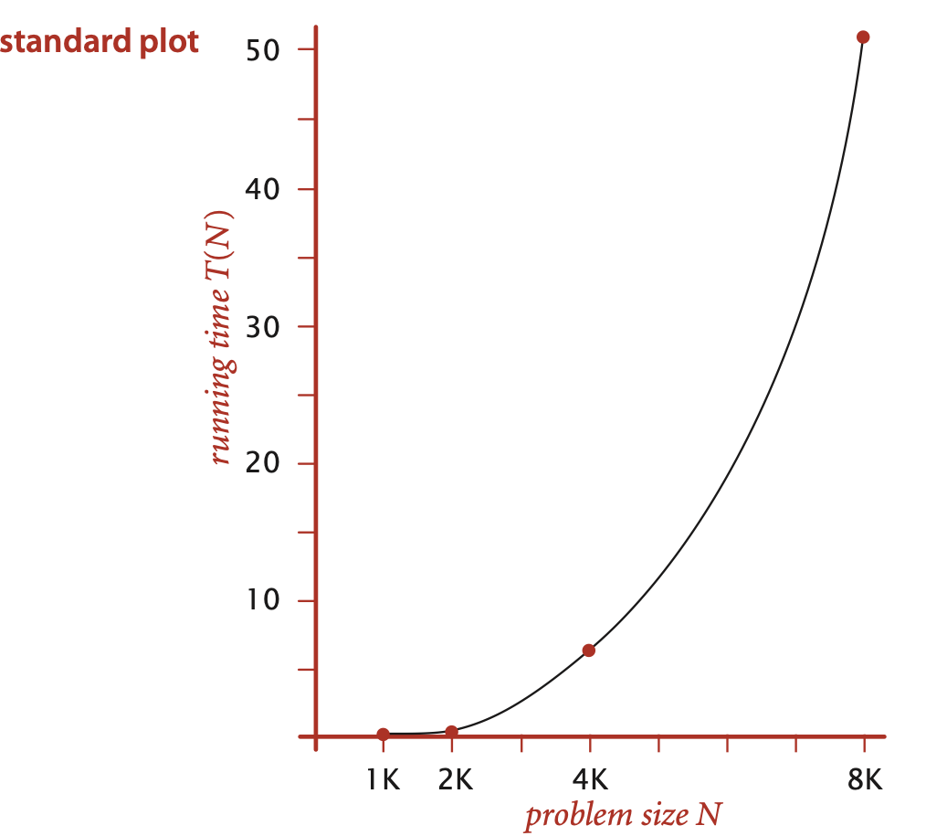
Data analysis
Standard plot. Plot running time T (N) vs. input size N.
a N ^{b}

Slide 47
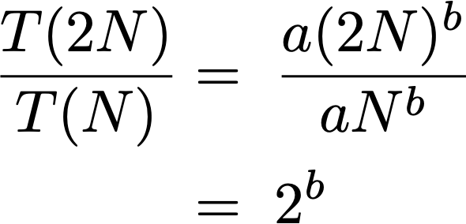
Doubling hypothesis
Doubling hypothesis. Quick way to estimate b in a power-law relationship.
Run program, doubling the size of the input.
Hypothesis. Running time is about a N ^{b} with b = lg ratio.
Caveat. Cannot identify logarithmic factors with doubling hypothesis.
N | time (seconds) † | ratio | lg ratio
250 | 0 |  | –
500 | 0 | 4,8 | 2,3
1.000 | 0,1 | 6,9 | 2,8
2.000 | 0,8 | 7,7 | 2,9
4.000 | 6,4 | 8 | 3
8.000 | 51,1 | 8 | 3
lg (6.4 / 0.8) = 3.0
seems to converge to a constant b ≈ 3
Notes:
put more emphasis on ratios with larger N since lots of noise contained in data for smaller N
do calculation T(2N) / T(N) = a(2N)^b / aN^b = 2^b on blackboard, whereT(N) = a N^b. Then take binary lg of both sides to get T(2N) / T(N) = b.

Slide 48
Doubling hypothesis
Doubling hypothesis. Quick way to estimate b in a power-law relationship.
Q. How to estimate a (assuming we know b) ?
A. Run the program (for a sufficient large value of N) and solve for a.
Hypothesis. Running time is about 0.998 × 10 ^{–10} × N ³ seconds.
N | time (seconds) †
8.000 | 51,1
8.000 | 51
8.000 | 51,1
51.1 = a × 8000³
⇒ a = 0.998 × 10 ^{–10}

Slide 49
Prediction and validation
Hypothesis. The running time is about 0.998 × 10 ^{–10} × N ³ seconds.
Predictions.
51.0 seconds for N = 8,000.
408.1 seconds for N = 16,000.
Observations.
"order of growth" of running time is about N³ [stay tuned]
N | time (seconds) †
8.000 | 51,1
8.000 | 51
8.000 | 51,1
16.000 | 410,8
validates hypothesis!
Notes:
lg(T(N)) = 2.9992 lg N - 33.2103, correlation coefficient = 1.0
Very accurate predictions.
2x input size -> 8x increase in running time for cubic algorithm

Slide 50
Analysis of Algorithms
Theory of algorithms

Slide 51
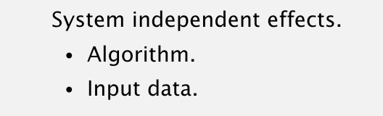
Types of analyses (consider input type)
Best case. Lower bound on cost.
Provides a goal for all inputs.
Worst case. Upper bound on cost.
Determined by “most difficult” input.
Provides a guarantee for all inputs.
Average case. Expected cost for random input.
Need a model for “random” input.
Provides a way to predict performance.
this course
Ex 1. Array accesses for brute-force 3-Sum. Best: ∼ N ³
Average: ∼ N ³
Worst: ∼ N ³
Ex 2. Compares for binary search.
Best: ∼ 1
Average: ∼ lg N
Worst: ∼ lg N

Slide 52
Theory of algorithms
Goals.
Establish “difficulty” of a problem.
Develop “optimal” algorithms.
Approach.
Suppress details in analysis: analyze “to within a constant factor.”
Eliminate variability in input: focus on the worst case.
Upper bound. Performance guarantee of algorithm for any input.
Lower bound. Proof that no algorithm can do better.
Optimal algorithm. Lower bound = upper bound (to within a constant factor).

Slide 53
Commonly-used notations in the theory of algorithms
Note that we focus on the worst case for algorithm theory understanding
notation | example | used to
Big Theta | Θ(N²) | classify algorithms
Big Oh | O(N²) | develop upper bounds
Big Omega | Ω(N²) | develop lower bounds

Slide 54
Theory of algorithms: example 1
Goals.
Establish “difficulty” of a problem and develop “optimal” algorithms.
Ex. 1-Sum = “Is there a 0 in the array? ”
Upper bound. A specific algorithm.
Ex. Brute-force algorithm for 1-Sum: Look at every array entry.
Running time of the algorithm for 1-Sum is O(N).
Lower bound. Proof that no algorithm can do better.(Lower Bound for Worst Case)
Ex. Have to examine all N entries (any unexamined one might be 0).
Running time of an optimal algorithm for 1-Sum is Ω(N).
Optimal algorithm.
Lower bound equals upper bound (to within a constant factor).
Ex. Brute-force algorithm for 1-Sum is optimal: its running time is Θ(N).

Slide 55
Theory of algorithms: example 2
Goals.
Establish “difficulty” of a problem and develop “optimal” algorithms.
Ex. 3-Sum.
Upper bound. A specific algorithm.
Ex. Brute-force algorithm for 3-Sum.
Running time of the optimal algorithm for 3-Sum is O(N ³).

Slide 56
Theory of algorithms: example 2
Goals.
Establish “difficulty” of a problem and develop “optimal” algorithms.
Ex. 3-Sum.
Upper bound. A specific algorithm.
Ex. Improved algorithm for 3-Sum.
Running time of the optimal algorithm for 3-Sum is O(N ² log N ).
Lower bound. Proof that no algorithm can do better.
Ex. Have to examine all N entries to solve 3-Sum.
Running time of the optimal algorithm for solving 3-Sum is Ω(N ).
Open problems.
Optimal algorithm for 3-Sum?
Subquadratic algorithm for 3-Sum?
Quadratic lower bound for 3-Sum?

Slide 57
Algorithm design approach
Start.
Develop an algorithm.
Prove a lower bound.
Gap?
Lower the upper bound (discover a new algorithm).
Raise the lower bound (more difficult).
Golden Age of Algorithm Design.
1970s‑.
Steadily decreasing upper bounds for many important problems.
Many known optimal algorithms.
Caveats.
Overly pessimistic to focus on worst case?
Need better than “to within a constant factor” to predict performance.

Slide 58
Commonly-used notations in the theory of algorithms
Common mistake. Interpreting big-Oh as an approximate model.
This course. Focus on approximate models: use Tilde-notation
notation | provides | example | shorthand for | used to
Tilde | leading term | ~ 10 N ² | 10 N ² 10 N ² + 22 N log N 10 N ² + 2 N + 37 | provide approximate model
Big Theta | asymptotic order of growth | Θ(N²) | ½ N ² 10 N ² 5 N ² + 22 N log N + 3N | classify algorithms
Big Oh | Θ(N²) and smaller | O(N²) | 10 N ² 100 N 22 N log N + 3 N | develop upper bounds
Big Omega | Θ(N²) and larger | Ω(N²) | ½ N ² N ⁵ N ³ + 22 N log N + 3 N | develop lower bounds

Slide 59
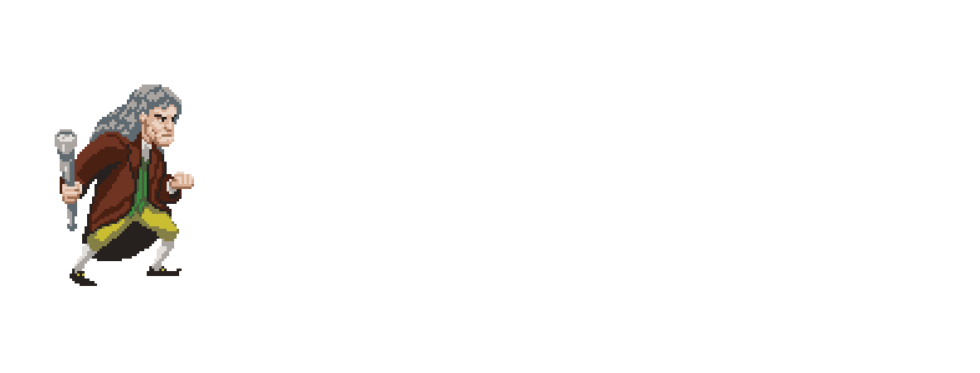
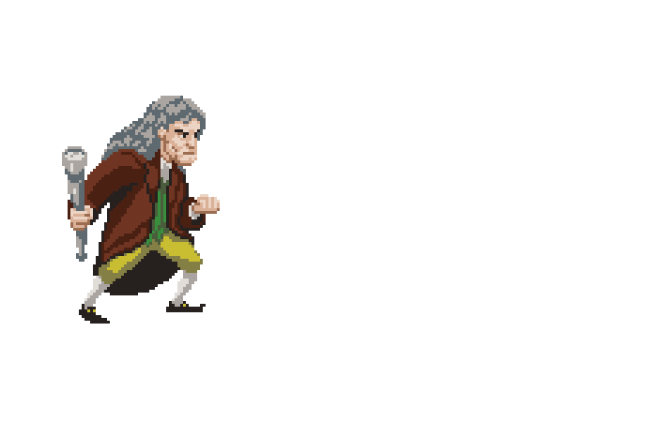

Slide 60
Analysis of Algorithms
mathematical models

Slide 61
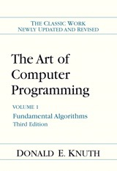
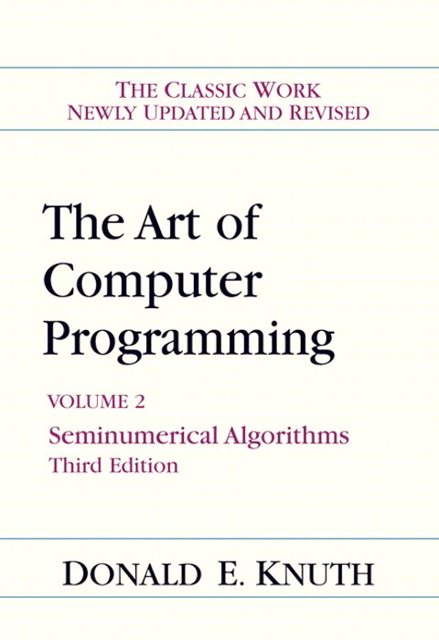
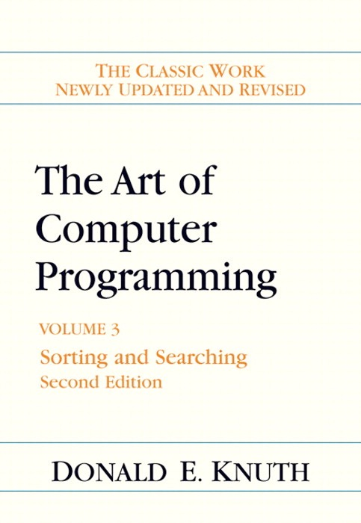
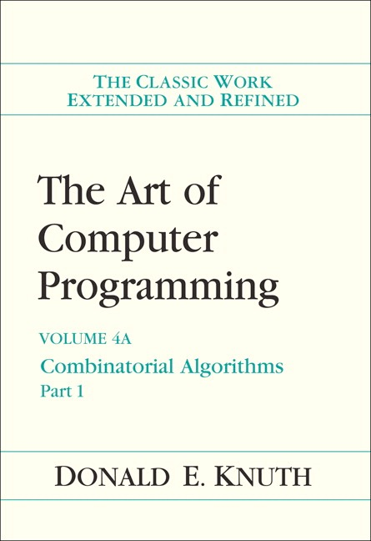
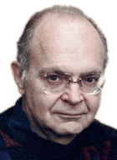
Mathematical models for running time
Total running time: sum of cost × frequency for all operations.
Need to analyze program to determine set of operations.
Cost depends on machine, compiler.
Frequency depends on algorithm, input data.
In principle, accurate mathematical models are available.
Donald Knuth 1974 Turing Award
Notes:
most famous modeling by Knuth - detailed results to accurate predict running time
Knuth's idea seems obvious in hindsight, but in the 1960s, programmers said it would never be possible to analyze the running time of a computer program since they are too complicated. Knuth's TAOCP is now a classic treatise on the subject.

Slide 62
Mathematical models for running time
In principle, accurate mathematical models are available.
Total running time: sum of cost × frequency for all operations.
Need to analyze program to determine set of operations.
Cost depends on machine, compiler.
Frequency depends on algorithm, input data.
costs (depend on machine, compiler)
TN = c1 A + c2 B + c3 C + c4 D + c5 E
A = array access
B = integer add
C = integer compare
D = increment
E = variable assignment
frequencies
(depend on algorithm, input)

Slide 63
Cost of basic operations
Observation. Most primitive operations take constant time.
Caveat. Non-primitive operations often take more than constant time.
operation | example | nanoseconds †
variable declaration | int a | c1
assignment statement | a = b | c2
integer compare | a < b | c3
array element access | a[i] | c4
array length | a.length | c5
1D array allocation | new int[N] | c6 N
2D array allocation | new int[N][N] | c7 N ²

Slide 64
Example: 1-Sum
Q. How many instructions as a function of input size N ?
int count = 0;
for (int i = 0; i < N; i++)
if (a[i] == 0)
count++;
N array accesses
operation | frequency
variable declaration | 2
assignment statement | 2
less than compare | N + 1
equal to compare | N
array access | N
increment | N to 2 N
Notes:
that's the cost of each operation; more interestingly is the frequency of each operation
walk through frequency count for array accesses
consider putting in instruction counts for N = 10000
increment: between N (no zeros) and 2N (all zeros)

Slide 65
Example: 2-Sum
Q. How many instructions as a function of input size N ?
int count = 0;
for (int i = 0; i < N; i++)
for (int j = i+1; j < N; j++)
if (a[i] + a[j] == 0)
count++;
operation | frequency
variable declaration | N + 2
assignment statement | N + 2
less than compare | ½ (N + 1) (N + 2)
equal to compare | ½ N (N − 1)
array access | N (N − 1)
increment | ½ N (N − 1) to N (N − 1)
tedious to count exactly
Notes:
N(N-1) instead of ½ N(N-1) because there are two array accesss per inner loop

Slide 66
Simplification 1: approximate cost model
Cost model. Use some basic operation as a proxy for running time.
int count = 0;
for (int i = 0; i < N; i++)
for (int j = i+1; j < N; j++)
if (a[i] + a[j] == 0)
count++;
operation | frequency
variable declaration | N + 2
assignment statement | N + 2
less than compare | ½ (N + 1) (N + 2)
equal to compare | ½ N (N − 1)
array access | N (N − 1)
increment | ½ N (N − 1) to N (N − 1)
cost model = array accesses
Notes:
arithmetic operations would also be a reasonable cost model
Ex 2. Cost model for union-find = array accesses.
Ex 3. Cost model for sorting = compares.

Slide 67
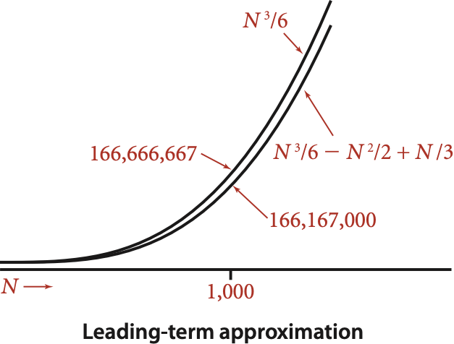
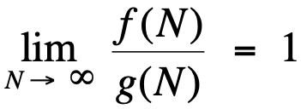
Simplification 2: tilde notation
Estimate running time (or memory) as a function of input size N.
Ignore lower order terms.
when N is large, terms are negligible
when N is small, we don't care
Ex 1. ⅙ N ³ + 20 N + 16 ~ ⅙ N ³
Ex 2. ⅙ N ³ + 100 N ^{4/3} + 56 ~ ⅙ N ³
Ex 3. ⅙ N ³ − ½ N ² + ⅓ N ~ ⅙ N ³
Technical definition. f(N) ~ g(N) means
discard lower-order terms (e.g., N = 1000: 166.67 million vs. 166.17 million)
Notes:
lower order term is 500,000

Slide 68
Simplification 2: tilde notation
Estimate running time (or memory) as a function of input size N.
Ignore lower order terms.
when N is large, terms are negligible
when N is small, we don't care
operation | frequency | tilde notation
variable declaration | N + 2 | ~ N
assignment statement | N + 2 | ~ N
less than compare | ½ (N + 1) (N + 2) | ~ ½ N ²
equal to compare | ½ N (N − 1) | ~ ½ N ²
array access | N (N − 1) | ~ N ²
increment | ½ N (N − 1) to N (N − 1) | ~ ½ N ² to ~ N ²

Slide 69
Example: 2-Sum
Q. Approximately how many array accesses as a function of input size N ?
A. ~ N ² array accesses.
Bottom line. Use cost model and tilde notation to simplify counts.
int count = 0;
for (int i = 0; i < N; i++)
for (int j = i+1; j < N; j++)
if (a[i] + a[j] == 0)
count++;
"inner loop"

Slide 70
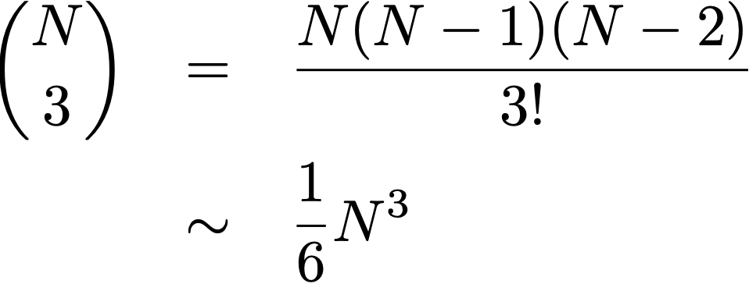
Example: 3-Sum
Q. Approximately how many array accesses as a function of input size N ?
A. ~ 1/2 N ³ array accesses.
Bottom line. Use cost model and tilde notation to simplify counts.
int count = 0;
for (int i = 0; i < N; i++)
for (int j = i+1; j < N; j++)
for (int k = j+1; k < N; k++)
if (a[i] + a[j] + a[k] == 0)
count++;
"inner loop"
Notes:
N^3 / 6 arises because N choose 3 is the number of triples i, j, k
½ N^3 because there are three array accesses in the inner loop

